Slide 1
IEEE Central Texas Section
2019 Fall Leadership Planning Meeting
August 24, 2018
San Marcos, TX
IEEE Communication Portal
IEEE Sponsored Student Projects
Prepared by: Dr. Aslan

Slide 2
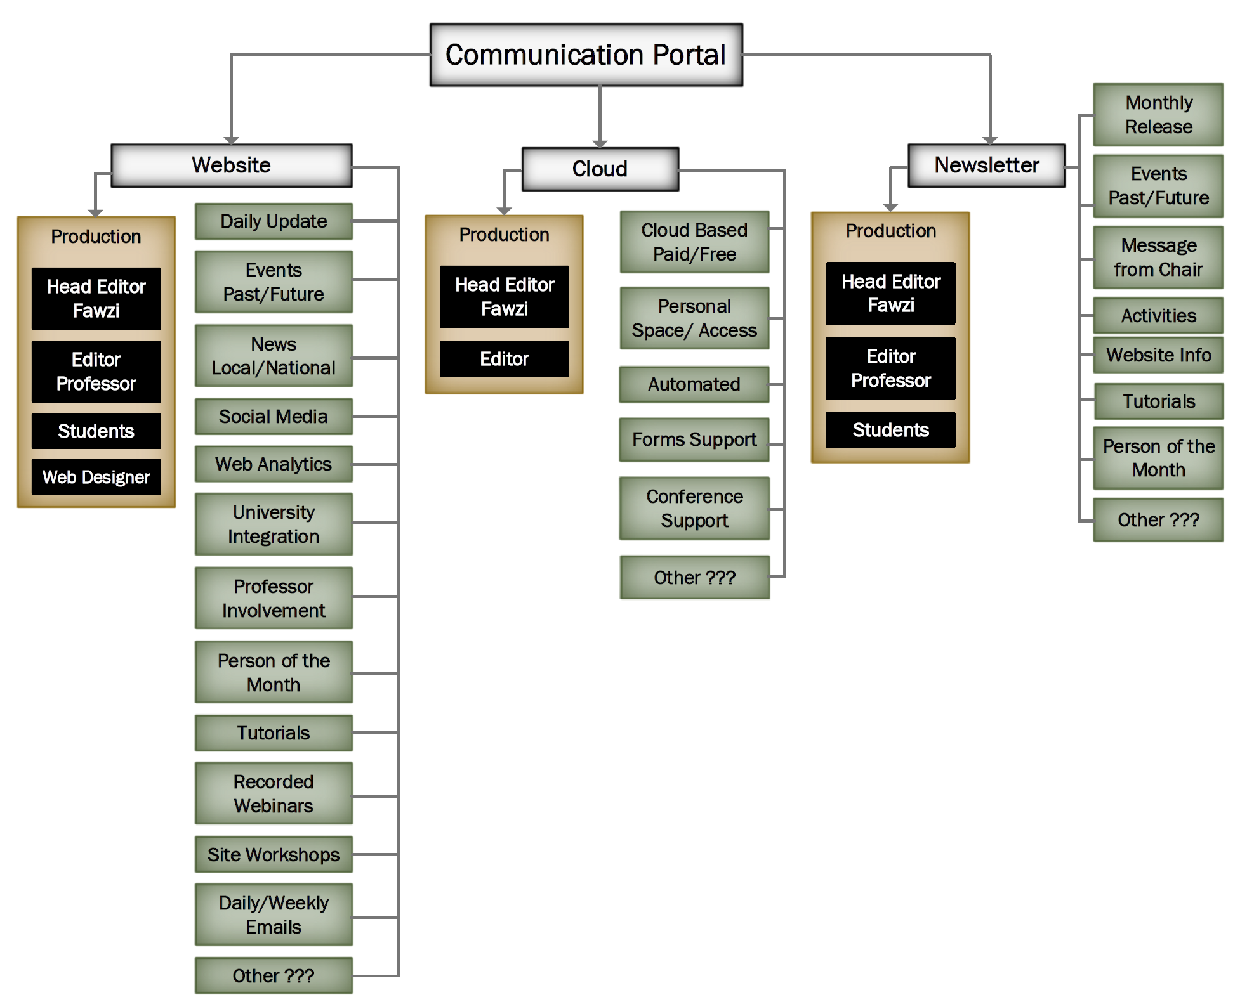
IEEE Communication Portal
Newsletter
Document Cloud
Social Media
Webpage
(https://r5.ieee.org/ctx/)

Slide 3
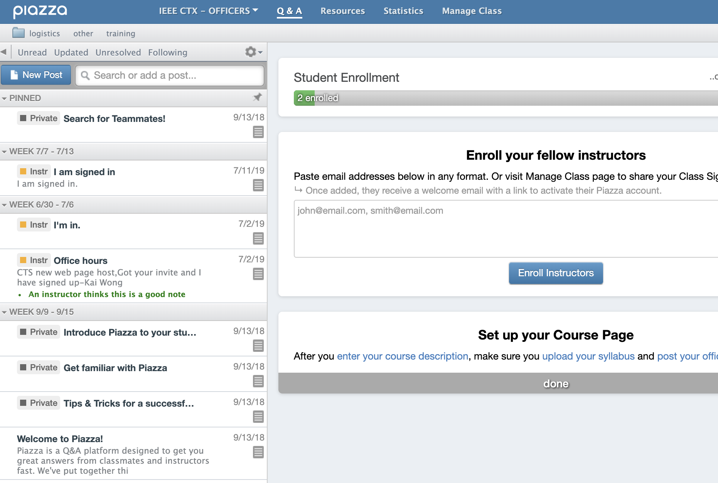
Communication Portal

Slide 4
Newsletter
Monthly Release
Delivery Method
  PDF
  HTML
Message from Chair
Events - Past/Future
News - Local/National
Chapter of the month
Person of the Month
Tutorials
  Programming
  Project
Special announcement
Jobs
Others

Slide 5
Webpage
Daily Update
Events - Past/Future
News - Local/National
Chapters
Social Media
Web Analytics
Industry / University Integration
Person of the Month
Tutorials/Workshops
Recorded Webinars
Site Workshops
Daily/Weekly Emails
Jobs
Outreach/Volunteer Activities
Others

Slide 6
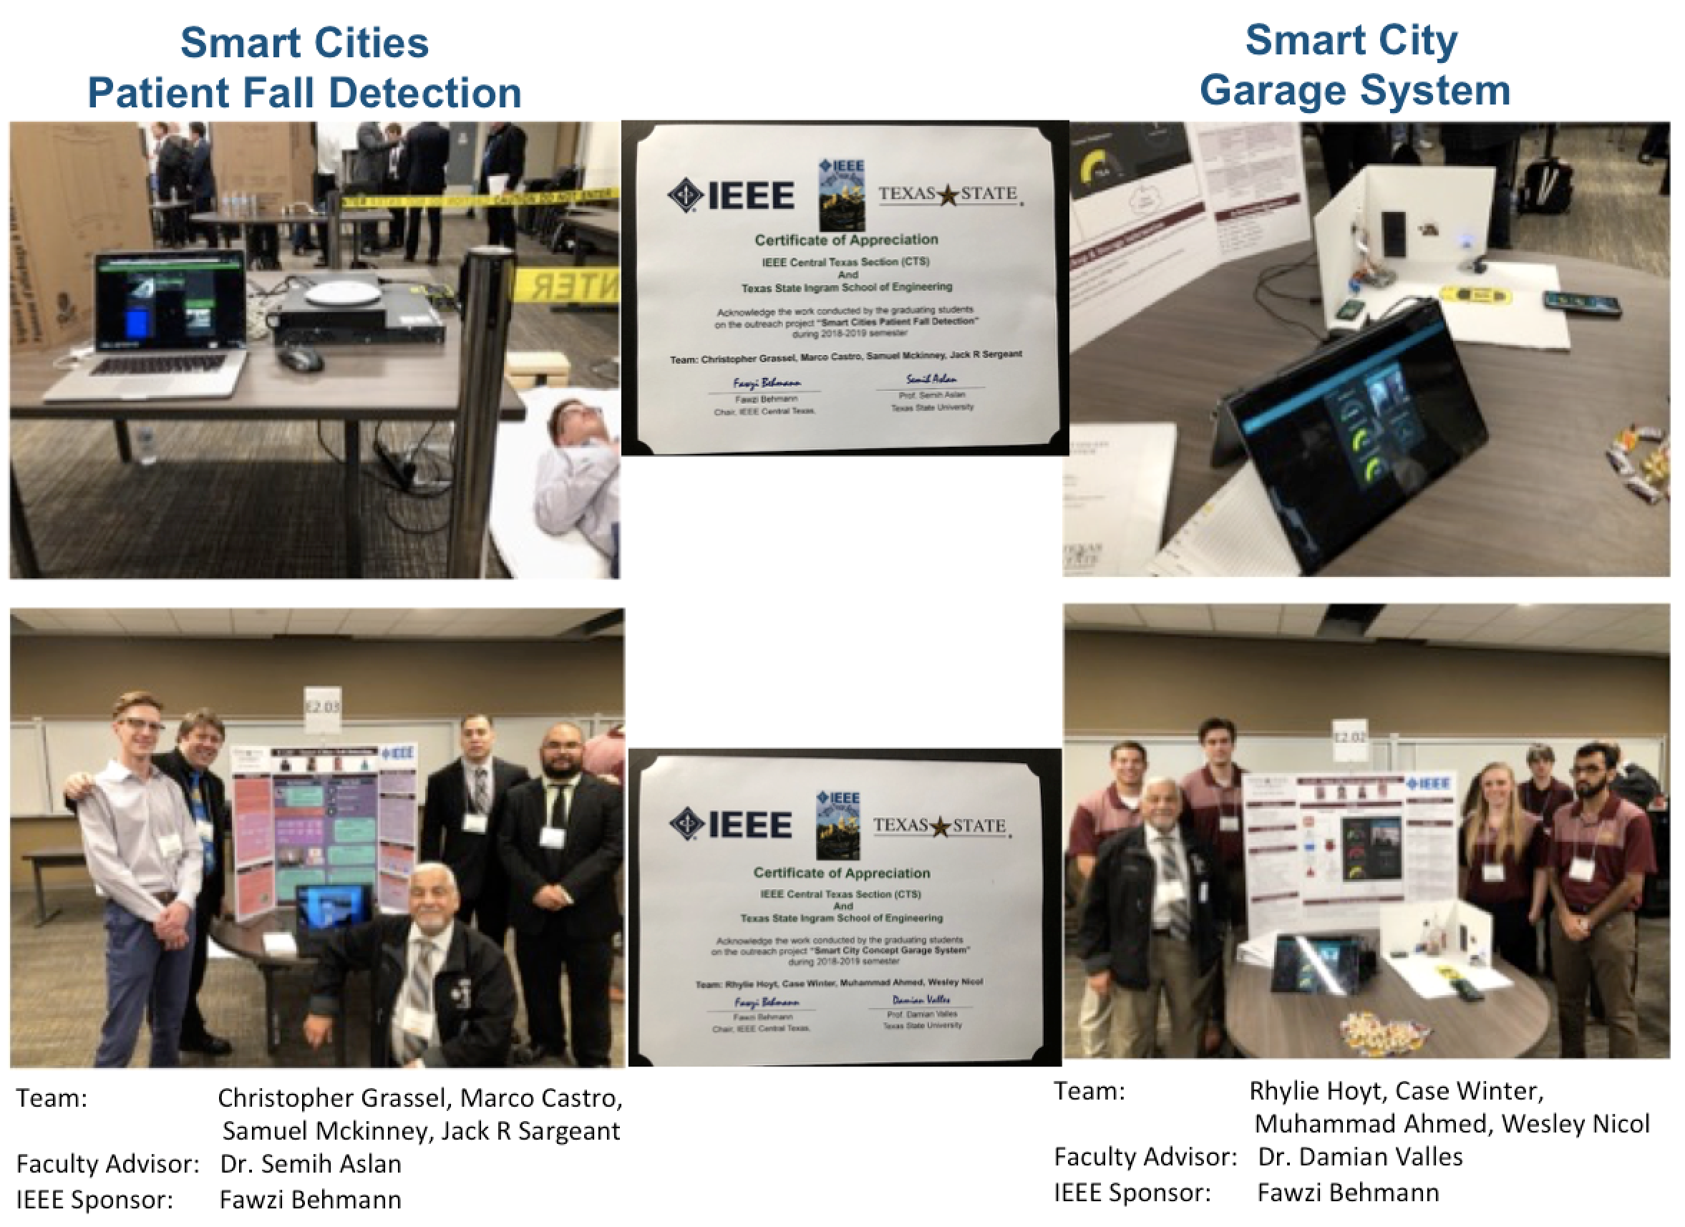
IEEE Sponsored Student Projects
2018 – 2019

Slide 7
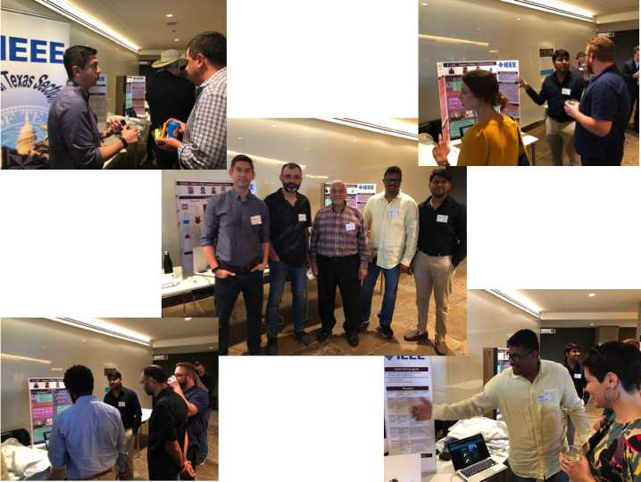
IEEE Sponsored Student Projects
Texas Smart Cities Summit

Slide 8
IEEE Sponsored Student Projects
2019 – 2020
Possible 4 projects (IoT Smart City)
Patient Fall Detection and Warning System (Final Product)
Car Garage Smart Design (Final Product)
Automated Traffic Light System
Smart Signs
Connected Vehicles/Dedicated Short Range Communications
Flood Detection System
Scooters & Bikes
Smart Parking System
Traffic Intersection Data Collection and Analysis
Air Quality
Smart Home Energy Monitoring System
Water Monitoring System
OTHER ???

Slide 9
Q/A
Semih Aslan, PhD
Associate Professor, Electrical Engineering
Director, SMART Lab
Ingram School of Engineering
Texas State University
601 University Dr, IGRM 4311
San Marcos, TX 78666
Tel (Cell): 773.344.8055
Tel (Office): 512.245.7235
Email: aslan@txstate.edu
Fax: 512.245.7771

